Slide 1

Presentation on Class and Objects with Real World Example
Presented by Praveen Chakravarthi

Slide 2
Agenda
Quick look on What is Class and Objects
Real World Examples of Class and Objects

Slide 3
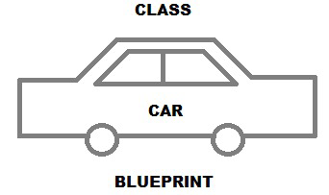

What is a Class?
A Class is nothing but a BLUEPRINT or TEMPLATE for creating different objects of different State and Behaviour.
A Class doesn’t allocate any Memory when it is created

Slide 4
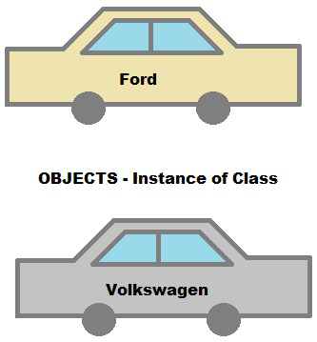
What is an Object?
An Object is an Instance of Class which can be a product of the BluePrint i.e. Class
An Object possess 2 Characteristics :
State and Behaviour
An Objects allocates memory when it is created

Slide 5
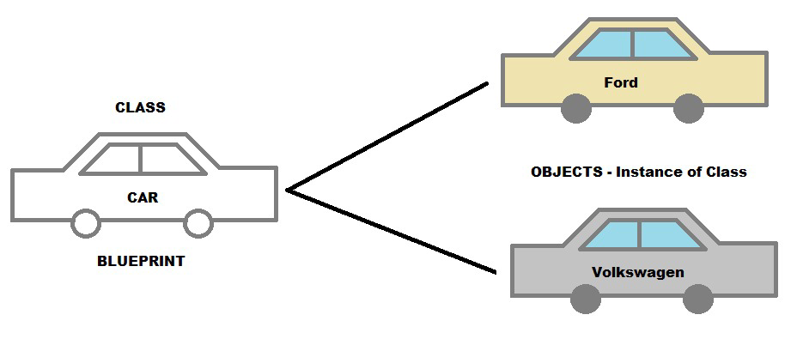
Difference…
A Class is a Category which is not a Real Word Entity whereas An Object is a Real World Entity
A Class can have ‘n’ no. of Objects as they may differ in Characteristics as discussed.

Slide 6
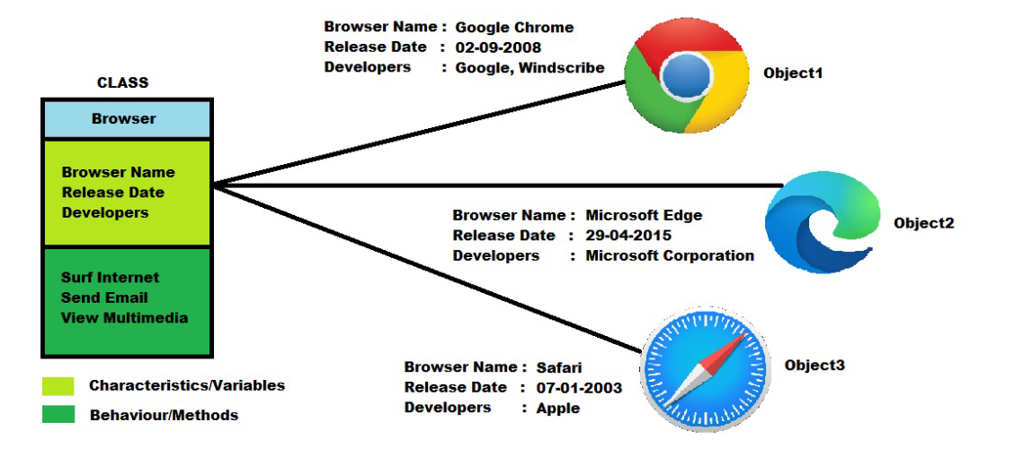
Real World Example
Here, I took a Class of Browser with certain Characteristics and Methods and created 3 objects as follows:

Slide 7
Thank You ! -Praveen Chakravarthi

